Slide 1
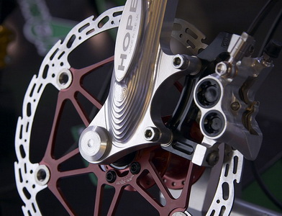
Solving Friction Problems
This lesson will give you the opportunity to apply the concepts of friction to solve friction problems

Slide 2
Learning Goals
By the end of this lesson, you will be able to:
solve problems involving friction

Slide 3
Success Criteria
Can I:
draw FBD’s with friction
apply F_{net} statements to solve for acceleration
solve dynamic related problems with friction

Slide 4
Sample Problem
A lawnmower of mass 12 kg is pushed with a force of 150 N [R] and 40. N [D]. If the kinetic coefficient of friction between the wheels and the grass is .90 what is the force of friction acting on the lawnmower?
next we draw an FBD

Slide 5
F_{N}
m = 12 kg
F_{k}
F_{ax} = 150N
F_{g}
F_{ay} = 40 N

Slide 6
to find F_{N} we consider the forces in the y-dir
since the lawnmower is moving, the friction is kinetic

Slide 7
∴ The force of friction is 140 N [L]

Slide 8
Sample Problem
Find the acceleration of the lawnmower in the previous problem.
Sol’n: to find accel we consider the forces in the x-dir

Slide 9
using Newton’s 2nd Law
∴ The accel is .67 m/s² [R]

Slide 10
Sample Problem
Determine the accel of the system below if μ_{k} = .15
3.5 kg
2.5 kg

Slide 11
Sol’n: Step 1 – draw FBD’s of each object
F_{N}
F_{T}
m = 3.5 kg
F_{k}
F_{T}
m = 2.5 kg
F_{g}
F_{g}

Slide 12
Step 2 – write net F statements for each mass
a₁ must equal a₂ in mag otherwise the string would break or lose tension

Slide 13
∴ the accel of m₁= 3.2 m/s² [R] and m₂= 3.2 m/s² [D]

Slide 14
HOMEWORK
Read Section 4.3
Review Tutorial 1, 2, and 3
Questions 1 – 2 pg 174
1 – 2 pg 175
1 – 4 pg 177

